Slide 1
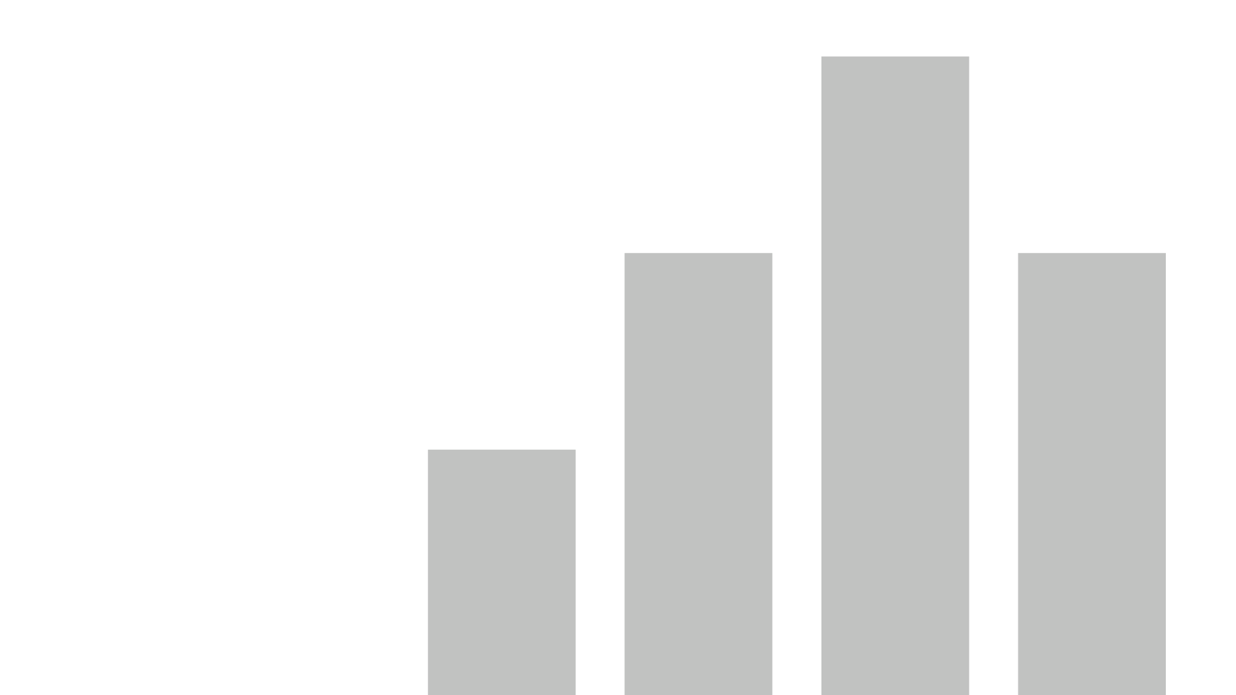


Final_Visualization-presentation
View in Power BI
Last data refresh:
4/5/2023 11:58:42 PM UTC
Downloaded at:
4/5/2023 11:59:46 PM UTC

Slide 2
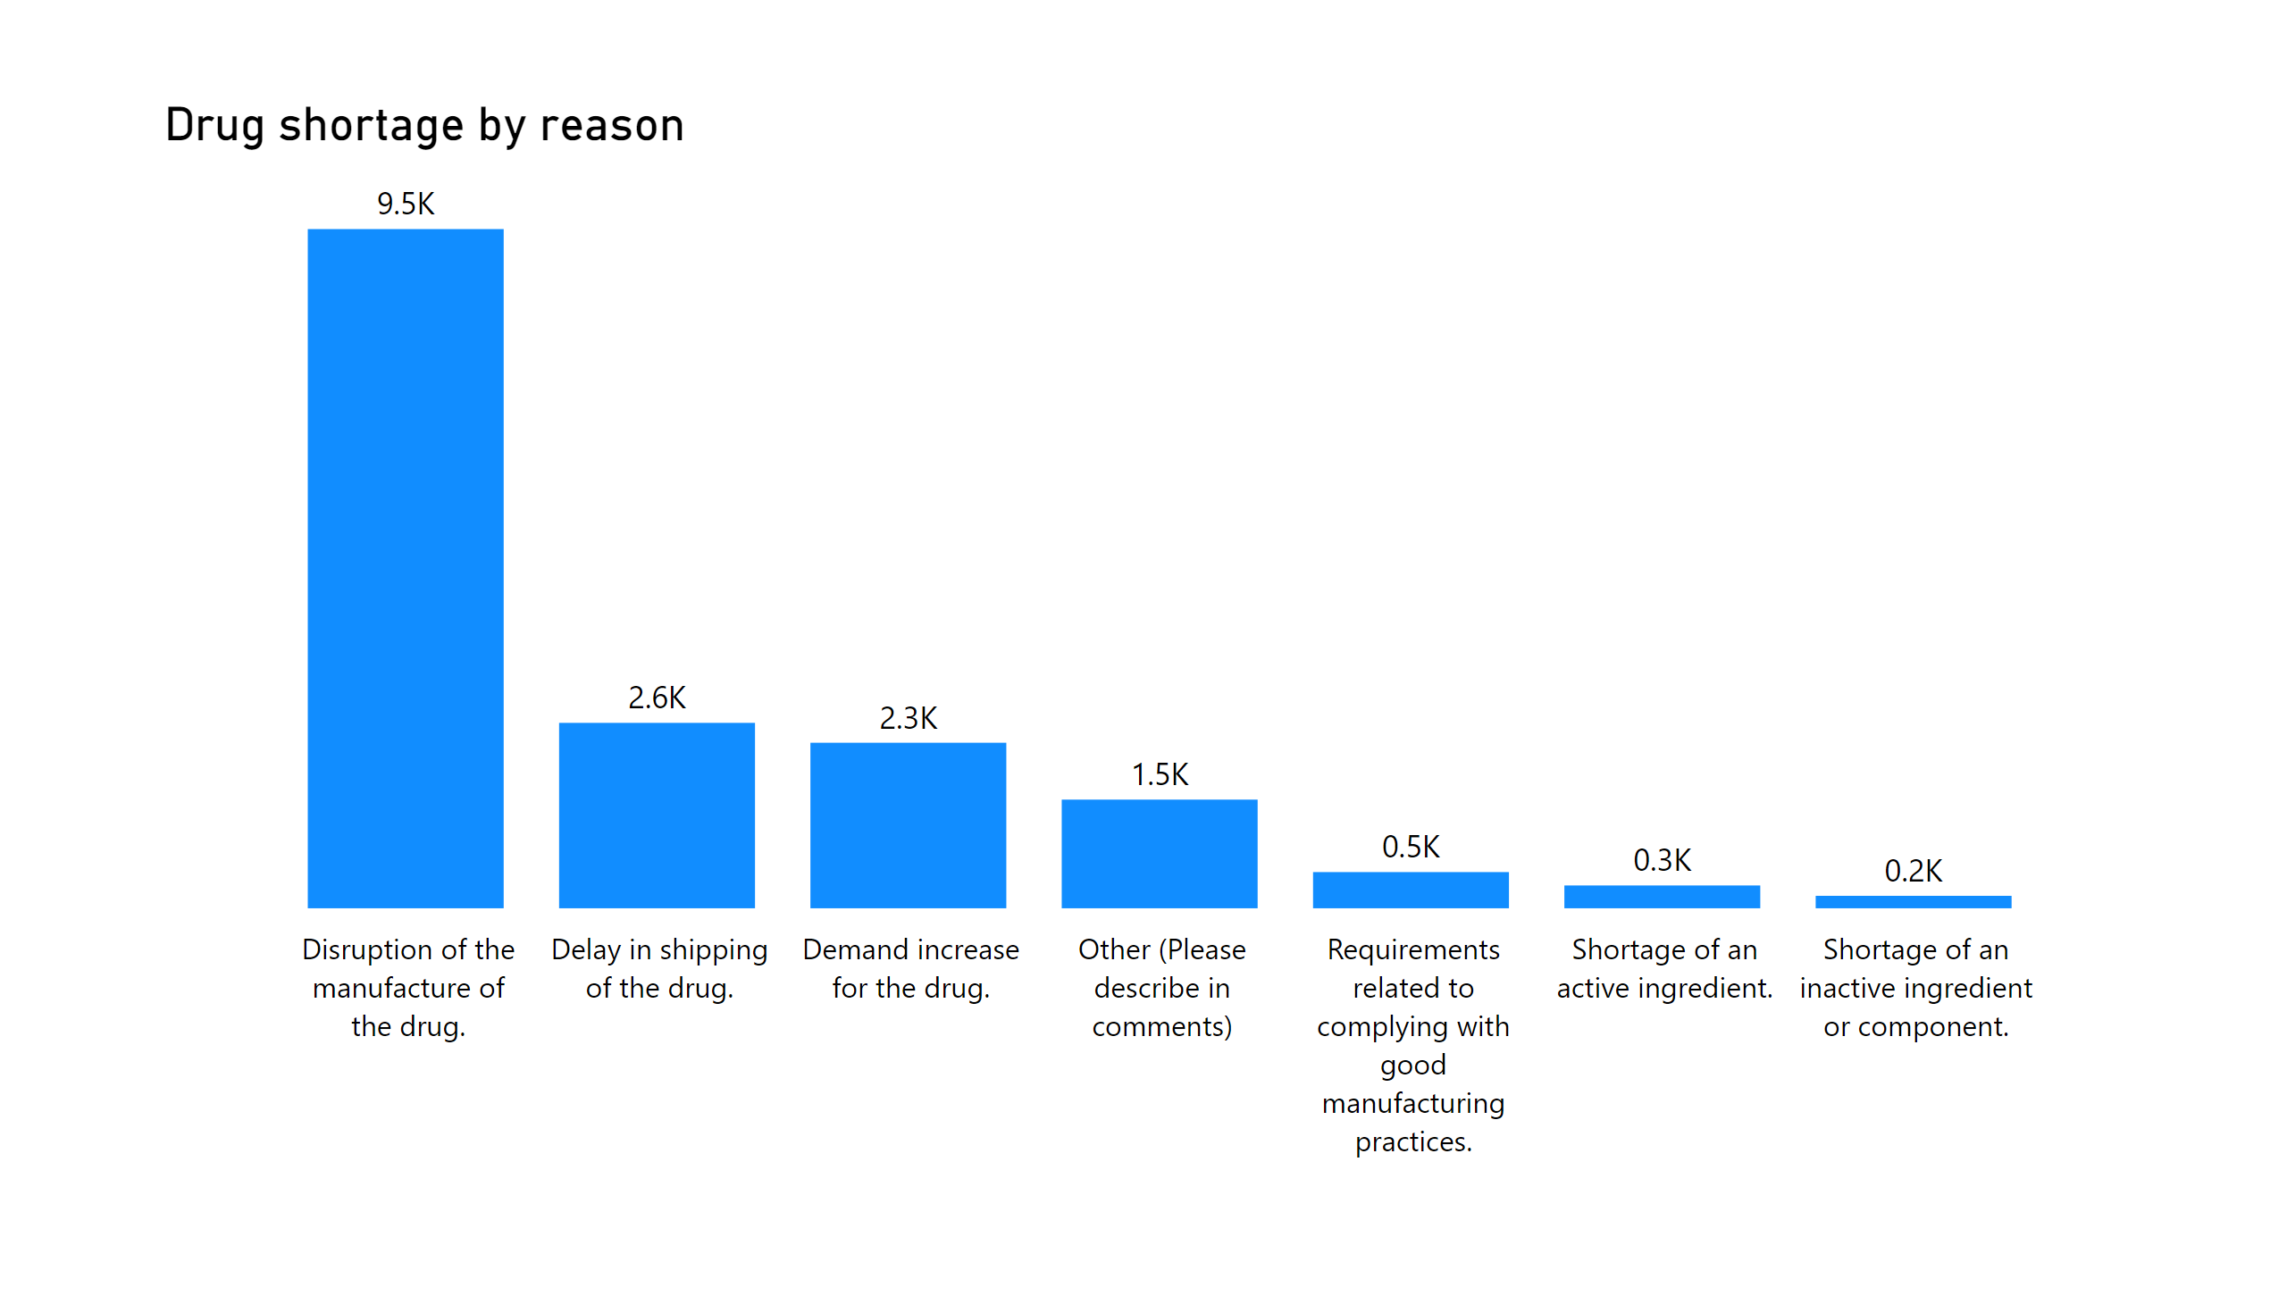
Shortage Reason
Notes:
Drug shortage by reason
No alt text provided

Slide 3
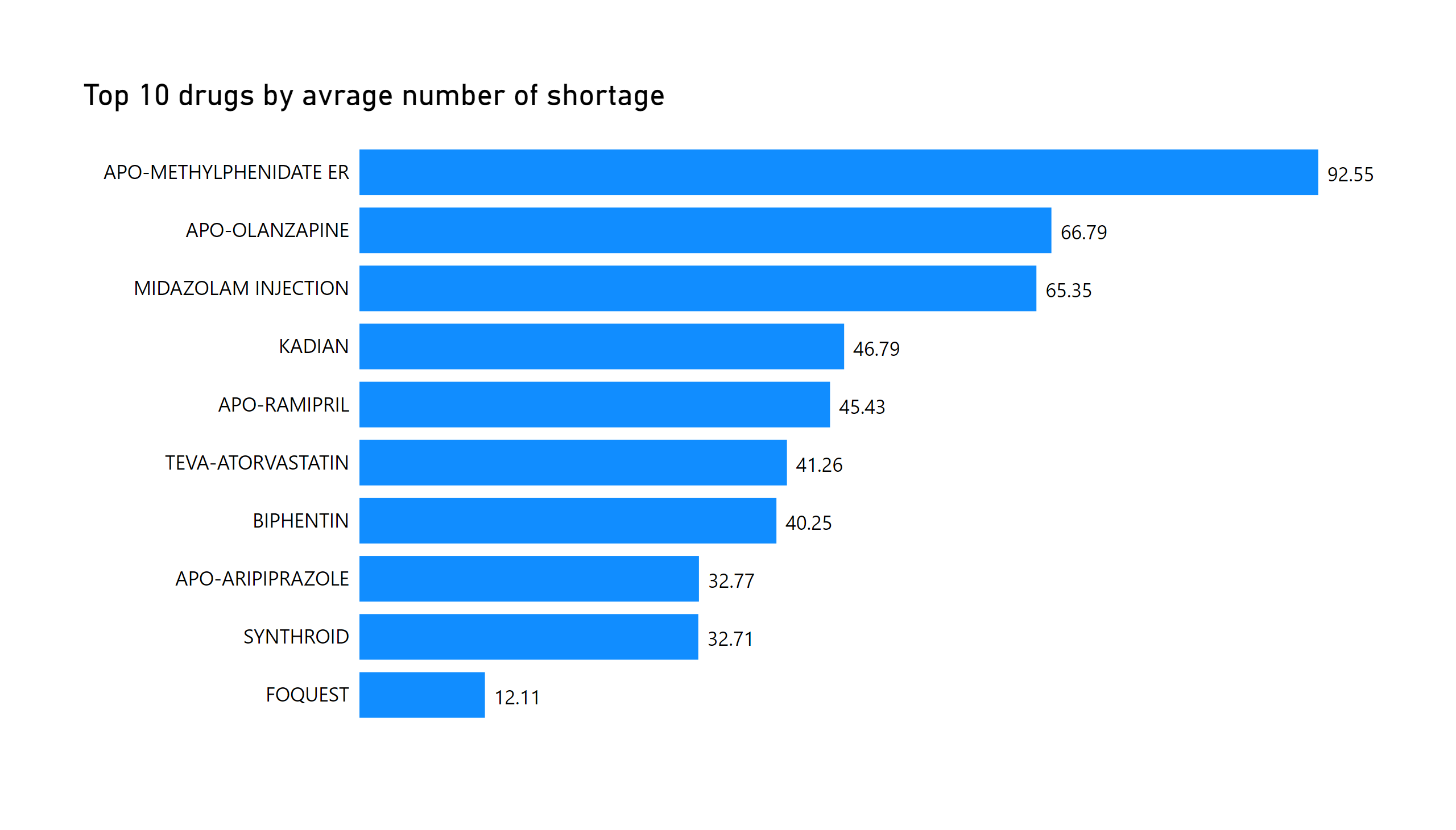
Top 10 Drugs
Notes:
Top 10 drugs by avrage number of shortage
No alt text provided

Slide 4
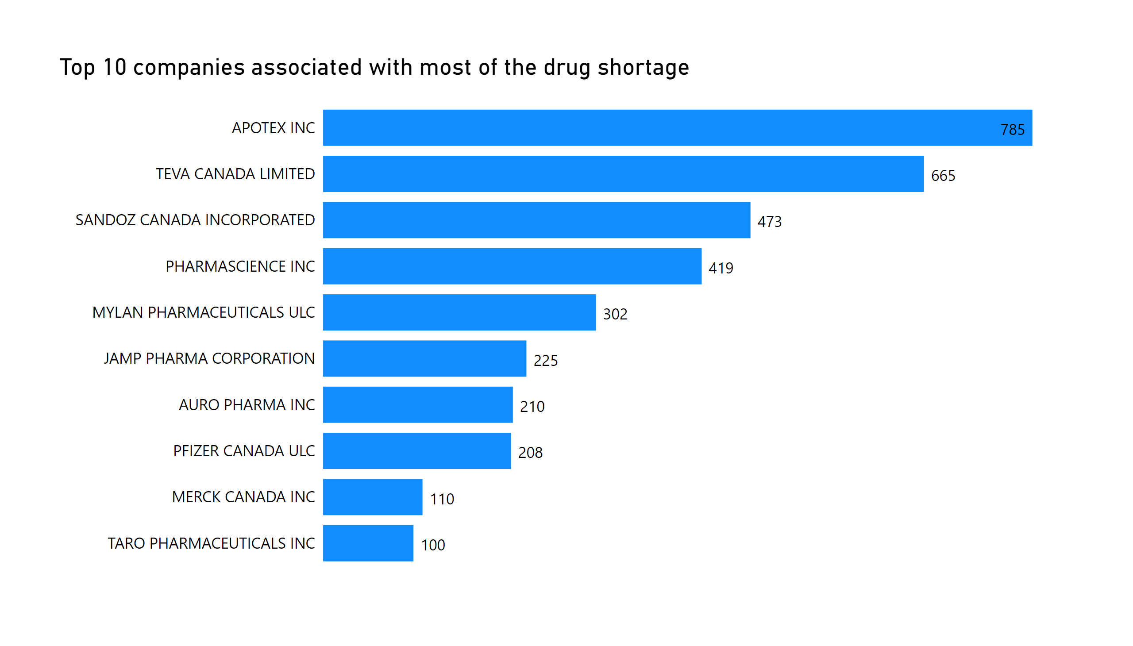
Top 10 Companies
Notes:
Top 10 companies associated with most of the drug shortage
No alt text provided

Slide 5
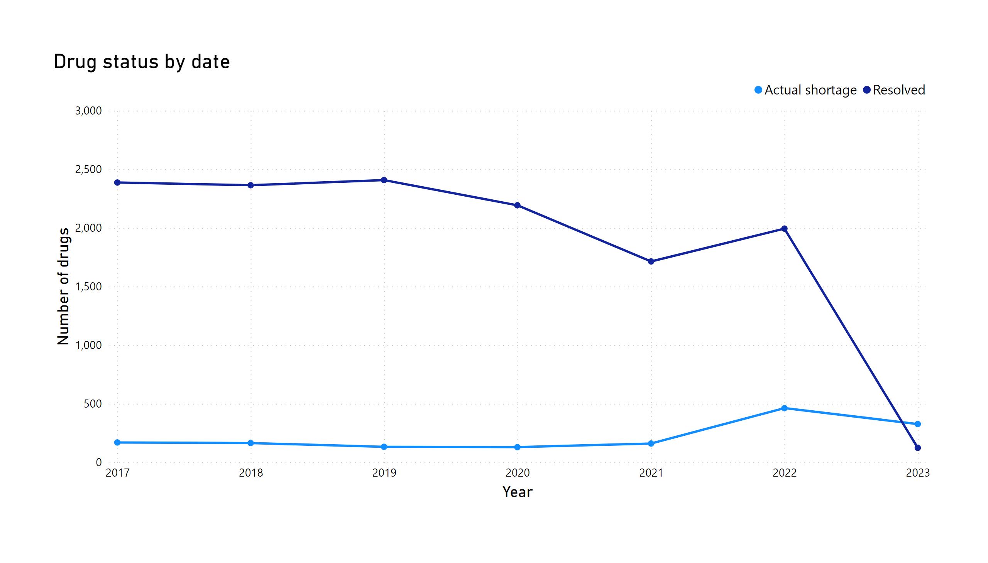
Drug Status
Notes:
Drug status by date
No alt text provided

Slide 6
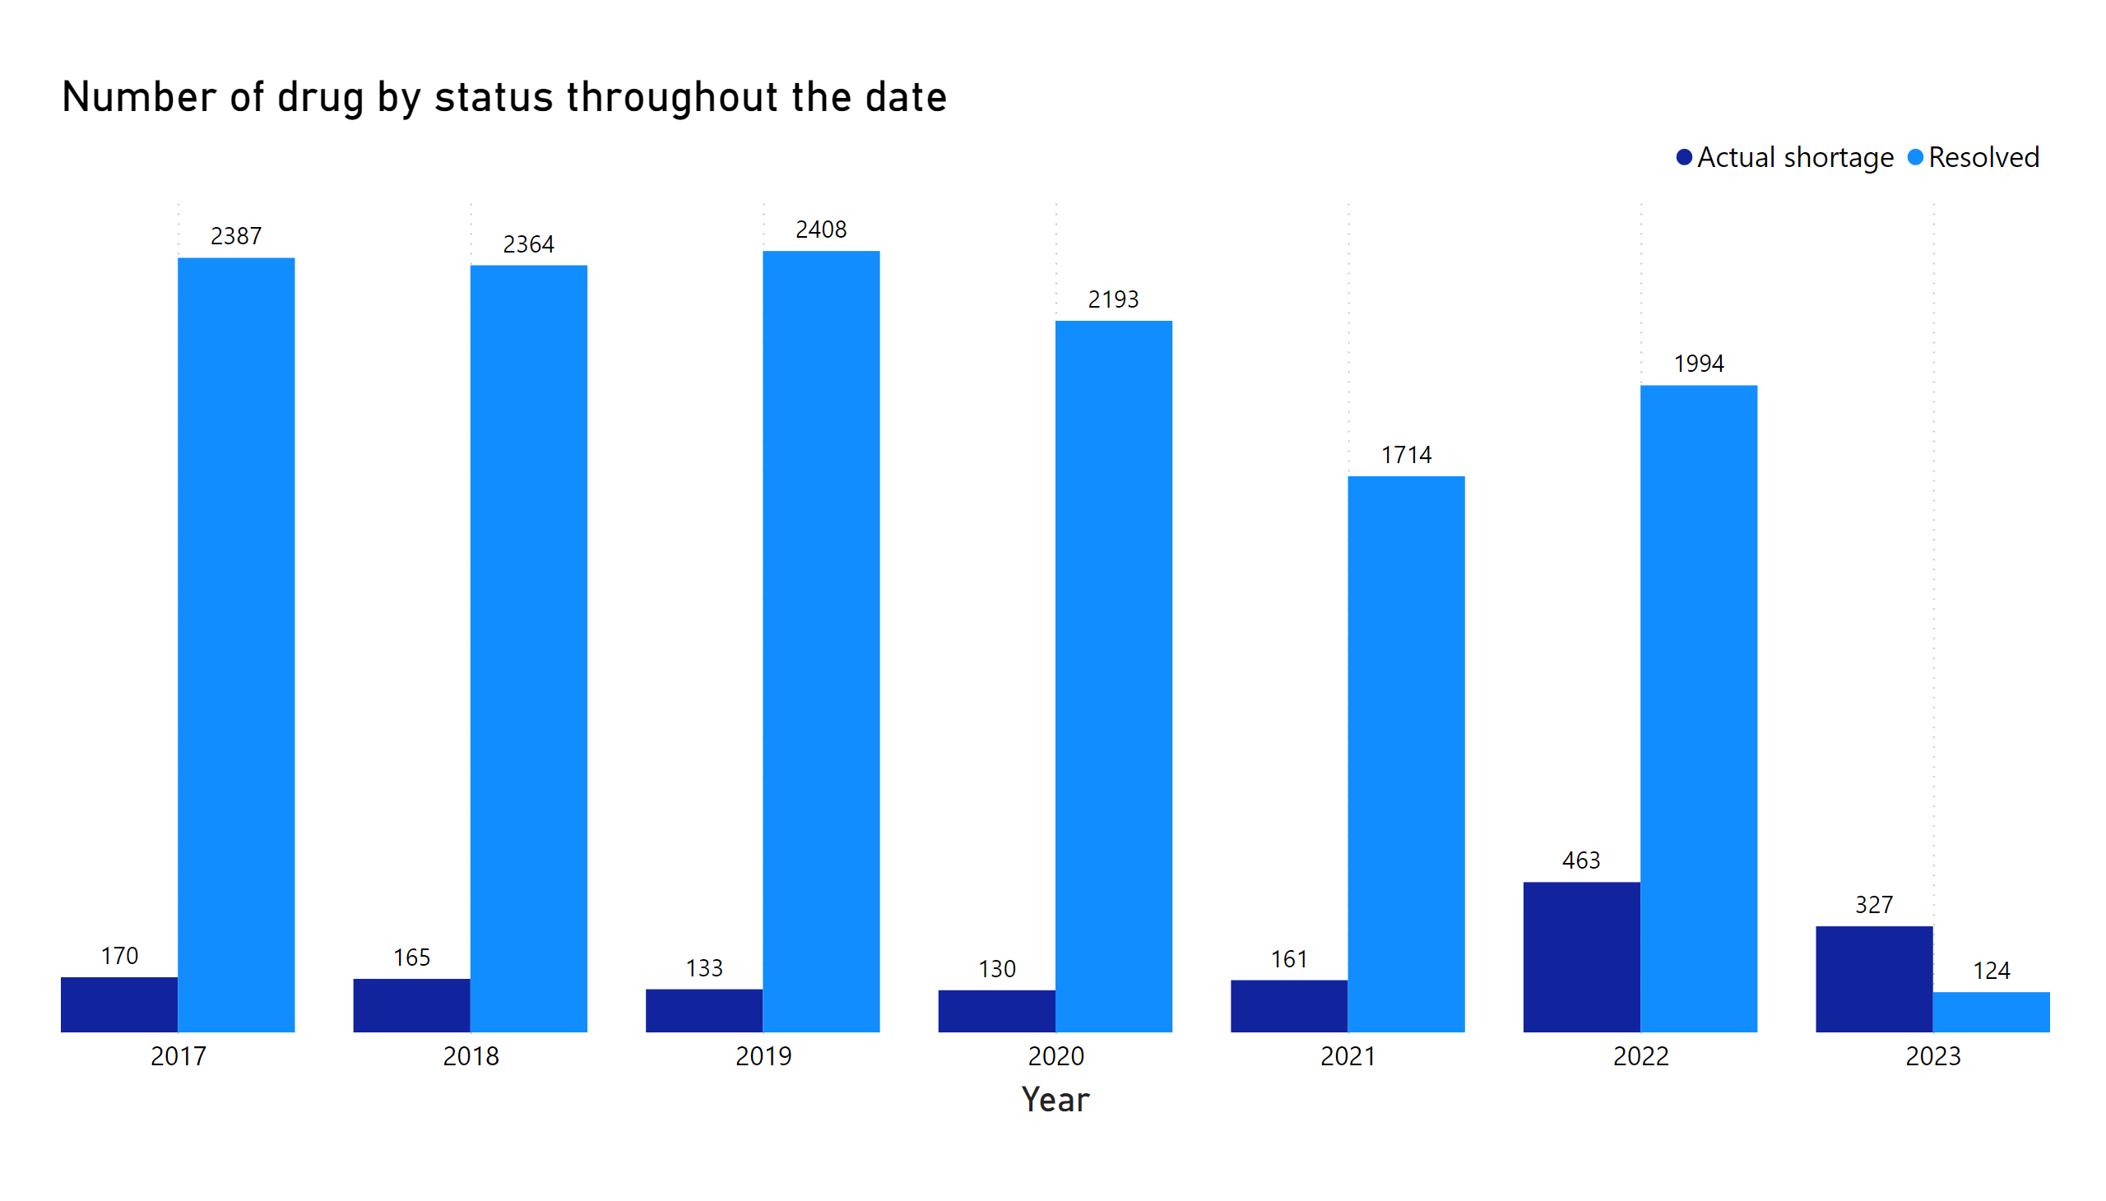
Status by Date
Notes:
Number of drug by status throughout the date
No alt text provided

